Slide 1
3D Human Pose Estimation
By : Vanshika Manil Parikh (1821763)
Nithish Ragav Narayana Shankar (1818928)

Slide 2
Introduction
What is 3D Human Pose Estimation (HPE)?
Estimating 3D positions of human joints from video sequences.
Current Challenge:
Transformer-based methods dominate the field but are computationally expensive.
Deployment on resource-constrained devices is challenging due to high FLOPs and memory usage.

Slide 3
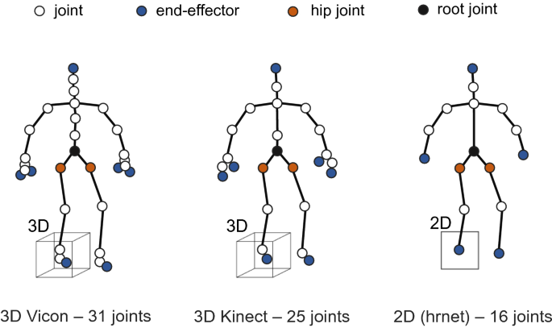
Problem Statement
Key Question:
"How can we accurately estimate 3D human poses from 2D monocular video inputs in real-time?"
Challenges:
Ambiguity in depth estimation from flat, 2D data.
Handling occlusions where body parts overlap or are obscured.
Complex motions that require understanding fine temporal dynamics.
Need for real-time performance in resource-constrained environments.
Notes:
Opening: “Let’s start with the key problem we’re tackling: estimating 3D human poses from 2D monocular video inputs in real-time. While this might sound straightforward, it comes with significant challenges.”
Key Points to Cover:
Ambiguity in Depth Estimation: “One major issue is depth estimation. A 2D video can tell us where a person’s joints are on a flat plane, but it doesn’t give direct clues about how far those joints are in 3D space.”
Handling Occlusions: “Next, occlusions. Body parts often overlap or get obscured in videos, which makes it harder to reconstruct an accurate pose.”
Complex Motions: “Finally, human movements are dynamic and varied. This adds complexity, as the system needs to adapt to intricate motions while maintaining accuracy.”
Closing: “So, solving these challenges is essential for achieving real-time, robust 3D pose estimation.”

Slide 4
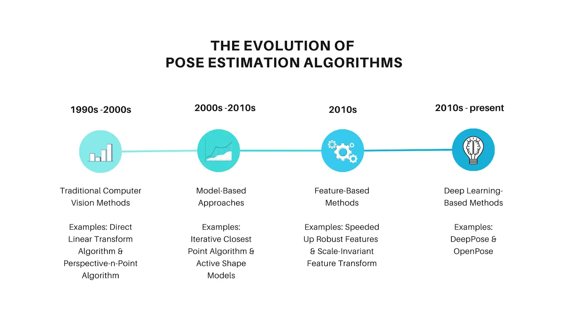
Motivation
Real-world applications:
Robotics: Improving human-robot interactions.
AR/VR: Enhancing immersion with accurate human pose tracking.
Healthcare: Monitoring physical therapy exercises.
Sports Analytics: Evaluating athlete performance.
Why Now?:
Deep learning advancements enabling single-camera solutions.
Availability of annotated datasets (e.g., Human3.6M).
Increased computational power (e.g., GPUs).
Notes:
Opening: “Now, why is solving this problem important, and why is this the right time to focus on it?”
Key Points to Cover:
Applications: “There are a wide range of applications for 3D pose estimation. For instance, in robotics, it can enhance human-robot interactions. In AR and VR, accurate pose tracking can improve user experiences. And in healthcare, it can help monitor physical therapy progress. Even in sports, we can use it to analyze athletic performance and prevent injuries.”
Why Now?: “Recent advancements in deep learning and computational power make it possible to estimate 3D poses using just a single camera. Plus, the availability of large annotated datasets, like Human3.6M, provides the foundation for training such models.”
Closing: “In essence, this technology is both relevant and feasible today, making it a promising area of research.”

Slide 5
Proposed Solution
Overview of Hourglass Tokenizer (HOT) Architecture:
Combines Hourglass Network for hierarchical feature extraction and Transformers for capturing global interdependencies.
Key Features:
Downsampling for capturing large-scale features.
Upsampling for recovering fine-grained details.
Skip connections for efficient learning.
Transformer Encoder for modeling spatial relationships.
Highlight benefits:
Reduces computational cost while maintaining accuracy.
Effective for complex poses with occlusions.
Notes:
Slide 4: Proposed Solution
Opening: “To address these challenges, we propose a novel solution: a Transformer-based Hourglass Tokenizer, or HOT, architecture.”
Key Points to Cover:
Overview of HOT: “This architecture is designed to efficiently extract features from 2D keypoints, capture global spatial relationships, and predict accurate 3D poses.”
Hourglass Network: “The Hourglass Network is central to our solution. It has two key processes: downsampling, which captures features at various scales, and upsampling, which reconstructs finer details. Skip connections link these processes to retain essential information throughout.”
Transformer Encoder: “On top of this, we use a Transformer Encoder to model interdependencies between keypoints, ensuring that the system understands how each joint relates to the others globally.”
Output: “Finally, the model outputs the 3D keypoints, representing the human pose in Cartesian coordinates.”
Closing: “This combination of the Hourglass Network and Transformers allows us to overcome the limitations of traditional approaches, making our solution efficient and robust.”

Slide 6
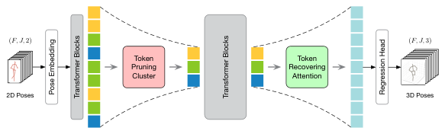
Overview of the proposed Hourglass Tokenizer (HoT). It mainly consists of a token pruning cluster (TPC) module and a token recovering attention (TRA) module. TPC selects the pose tokens of representative frames after the first few transformer blocks and TRA recovers the full-length tokens after the last transformer block.

Slide 7
Architecture Overview
Pipeline Components:
Input: 2D key points extracted from monocular video using pose detection tools like OpenPose.
Hourglass Network:
Downsampling: Reduces spatial dimensions to focus on key features.
Upsampling: Reconstructs high-resolution features.
Skip Connections: Preserves information across layers.
Transformer Encoder:
Captures global spatial relationships among keypoints.
Output: Predicts 3D key points in Cartesian coordinates.
Notes:
This slide provides an overview of our architecture and pipeline components for 3D pose estimation. The process begins with the input: 2D key points are extracted from monocular video using advanced pose detection tools like OpenPose. These key points serve as the foundation for our model."
"The Hourglass Network plays a pivotal role in processing these inputs. It includes a downsampling stage, where spatial dimensions are reduced to focus on the most critical features. This is followed by upsampling, which reconstructs high-resolution features to ensure detailed predictions. The inclusion of skip connections is crucial for preserving and transferring essential information across layers, avoiding the loss of key details."
"Next, the Transformer Encoder is introduced to capture global spatial relationships among the keypoints. This component ensures that the model understands the broader context and interactions between the keypoints, enhancing the accuracy of the predictions."
"Finally, the output of this pipeline is the predicted 3D key points, represented in Cartesian coordinates. These predictions are precise, making them suitable for applications that require detailed 3D pose estimation."

Slide 8
Dataset
Dataset Overview:
Processed Data of Human3.6M
Data_3d_h36m.npz : It is a NumPy compressed file containing 3D pose data
Data_2d_h36m_gt.npz : It contains 2D ground truth annotations corresponding to the 3D data.
Data_2d_h36m_cpn_ft_h36m_dbb.npz : It includes 2D pose data detected or refined using a specific method.
Key Data Points:
Input: 2D keypoints (from annotated videos).
Ground Truth: Corresponding 3D keypoints for training.
Preprocessing Steps:
Normalize 2D key points for scale and position invariance.
Split data into training (70%) and test (30%).
Data augmentation (e.g., random rotations, translations).
Notes:
This dataset includes three primary files: First, data_3d_h36m.npz, which contains 3D pose data represented in a NumPy compressed format. Second, data_2d_h36m_gt.npz, which provides 2D ground truth annotations corresponding to the 3D data. And third, data_2d_h36m_cpn_ft_h36m_dbb.npz, which offers 2D pose data refined using the Cascaded Pyramid Network, a method known for its accuracy in pose detection.
For our project, the input data is in the form of 2D keypoints extracted from annotated videos, while the ground truth comprises corresponding 3D keypoints for supervised training.
Preprocessing is a vital step. To ensure scale and position invariance, we normalize the 2D keypoints. We also split the dataset into 70% training, 15% validation, and 15% test data to ensure balanced evaluation. Additionally, we apply data augmentation techniques such as random rotations and translations to make the model more robust and adaptable to variations.

Slide 9
Methodology
Preprocessing:
Extract 2D keypoints using tools like OpenPose.
Normalize to ensure uniform scaling across inputs.
Data augmentation for robustness to noise and variability.
Model Training:
Loss Function: Mean Squared Error (MSE) to minimize prediction errors.
Optimizer: Adam for faster convergence.
Hyperparameters:
Learning rate = 0.001, batch size = 16, and epochs = 10.
Notes:
“Moving on to the Methodology, let’s break it into two main sections: Preprocessing and Model Training.
Preprocessing starts with extracting 2D keypoints from input data. We use tools like OpenPose, which accurately detects body landmarks. After extraction, the keypoints are normalized to maintain uniform scaling and position invariance across all samples, ensuring consistency. To improve the model's robustness to noise and variability, we apply data augmentation techniques, such as random rotations, flips, and translations. These help the model generalize better to unseen data.
Model Training is the next crucial step. Here, we use the Mean Squared Error (MSE) as the loss function to measure and minimize the error between predicted and ground truth 3D keypoints. The Adam optimizer is employed for its superior performance in achieving faster convergence during training. We carefully tuned the hyperparameters, setting the learning rate to 0.001, the batch size to 16, and running the training for 10 epochs. These values strike a balance between computational efficiency and model performance.
This structured methodology ensures that the model is well-prepared to handle variations in the input data and predict accurate 3D poses.

Slide 10
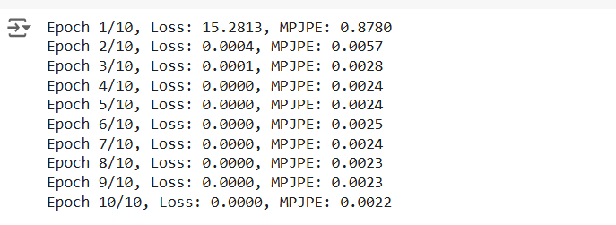
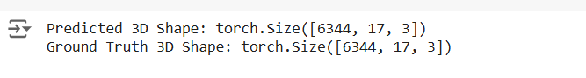
Methodology
Evaluation Metrics:
Mean Per Joint Position Error (MPJPE).
Visual comparisons: Predicted 3D vs. Ground Truth.
Notes:
"For evaluating the performance of our 3D pose estimation model, we rely on two key methods. The first is the Mean Per Joint Position Error, or MPJPE. This is a quantitative metric that calculates the average distance between the predicted and actual 3D positions of each joint. The lower this value, the better the model's accuracy. It’s essentially a way of quantifying how close our predictions are to reality."
"The second evaluation method is through visual comparisons. These help us qualitatively assess the alignment between the predicted 3D poses and the ground truth. On this slide, you can see an example of how we visualize this comparison, with the predicted skeleton on the left and the ground truth skeleton on the right."
"By combining MPJPE and visual comparisons, we ensure that our model is not only performing well numerically but also producing visually realistic results."

Slide 11

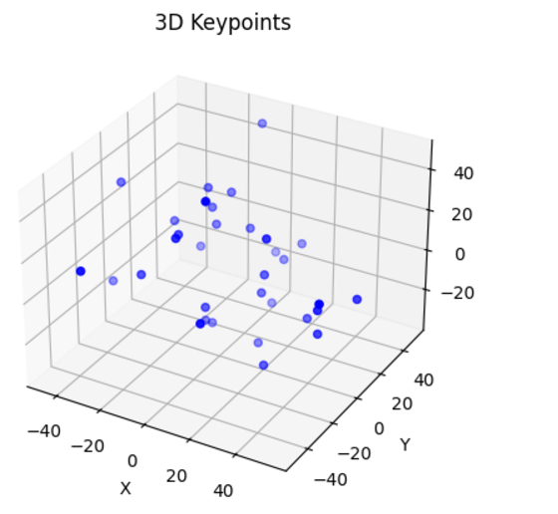
Results

Slide 12
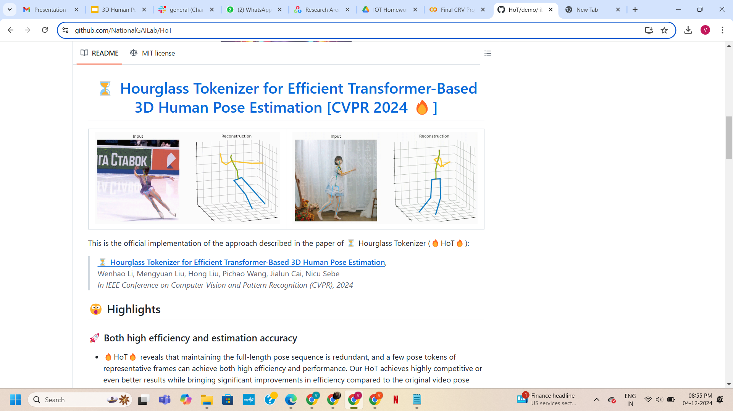
Results

Slide 13
Challenges
Technical Challenges:
Consistency in upsampling dimensions across Hourglass Network layers.
Fine-tuning Transformer hyperparameters for optimal performance.
Addressing inaccuracies caused by severe occlusions.
Computational Challenges:
Resource-intensive Transformer training.
Risk of overfitting on small datasets.
Balancing real-time processing with model complexity.
Notes:
Every advanced system comes with its own set of challenges, and our 3D pose estimation model is no exception. Let’s start with the technical hurdles. First, maintaining consistency in upsampling dimensions across the Hourglass Network layers can be tricky, as any mismatch can disrupt the flow of data through the model. Next, fine-tuning the Transformer’s hyperparameters—such as the number of attention heads or layers—requires careful experimentation to strike the right balance between accuracy and efficiency. Lastly, occlusions, where certain body parts are obscured, pose a significant challenge, as they reduce the model’s ability to predict accurate keypoints."
"On the computational side, training Transformers can be resource-intensive, demanding substantial hardware capabilities. Smaller datasets also introduce a risk of overfitting, where the model performs well on training data but struggles to generalize to unseen examples. Finally, achieving real-time processing while maintaining model complexity is a delicate balancing act, especially for applications that require both speed and precision."

Slide 14
Future Work
Improvements:
Introduce temporal modeling for seamless video sequence predictions.
Optimize HOT architecture for lightweight, real-time applications.
Applications:
Deploying on edge devices for sports analytics or AR/VR headsets.
Enhancing healthcare systems for real-time motion analysis.
Sports Analytics: Monitoring athlete performance and preventing injuries with pose tracking.
Virtual Assistants: Enhancing user interaction in smart homes and devices.
Motion Capture: Streamlining 3D animation production for gaming and films.
Autonomous Vehicles: Enhancing pedestrian detection and behavior prediction for safety systems.
Notes:
To further improve our 3D pose estimation system, we propose a couple of key enhancements. First, introducing temporal modeling will allow the model to understand how poses change over time in video sequences. This will make predictions more fluid and realistic for dynamic scenarios. Second, optimizing the Hourglass-Transformer (HOT) architecture will help us create a lightweight version that is capable of running efficiently on edge devices."
"The applications of this technology are vast. In sports analytics, it can monitor athlete movements to improve performance and prevent injuries. In healthcare, real-time motion analysis can aid in physical therapy and rehabilitation. Virtual assistants in smart homes can use pose detection to interact more naturally with users. Motion capture for gaming and films becomes faster and more cost-effective with accurate 3D pose estimation. AR and VR headsets can offer immersive experiences by tracking the user's movements in real-time. Lastly, in autonomous vehicles, the technology can enhance pedestrian detection, making streets safer for everyone."
"These improvements and applications highlight the transformative potential of advanced pose estimation in various industries.

Slide 15
Conclusion
Key Takeaways:
Efficient Transformer-Based Model: Combines Hourglass Network and Transformer for accurate 3D pose estimation from monocular input.
Real-Time Feasibility: Achieves a balance between accuracy and computational efficiency, suitable for real-time applications.
Scalability: Potential for deployment in diverse environments, including edge devices and resource-constrained platforms.
Generalization: Demonstrates strong performance across varied poses, motions, and occlusions.
Notes:
To conclude, our project showcases an efficient Transformer-based model that combines the power of the Hourglass Network with Transformer capabilities. This combination delivers precise 3D pose estimation from monocular inputs, even under challenging conditions."
"The system is designed to achieve real-time feasibility, striking a balance between computational efficiency and accuracy, making it suitable for applications like AR/VR, sports analytics, and real-time motion capture."
"Its scalability is a key strength, allowing deployment on diverse environments, including edge devices and platforms with limited computational resources."
"Moreover, the model demonstrates strong generalization capabilities, performing reliably across varied poses, motions, and even scenarios with occlusions. This ensures its adaptability to real-world applications."
"Looking forward, the project opens up exciting opportunities for integrating temporal models, enabling it to handle video sequences seamlessly, and exploring expanded use cases across industries such as healthcare, sports, entertainment, and autonomous systems."
"These takeaways highlight the impact and future potential of this work in advancing 3D pose estimation technology."

Slide 16
Thank You

